Slide 1

Architecture: Setting up Your Auth0 Tenant
Introduction
Notes:
This slide should be used as the cover of a presentation. Example: https://cloudup.com/cUNPNh4R21F

Slide 2
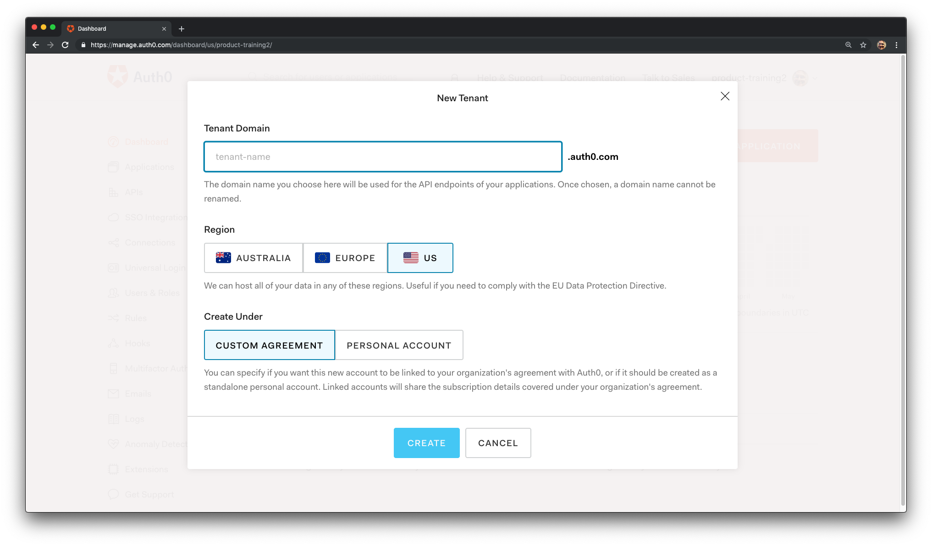

Auth0 Tenant
What is it?
How to configure?
How many are needed?
How to fit SDLC?
Notes:
In this video, we will talk about what an Auth0 tenant is, and show you how to configure it in the Auth0 Dashboard. We will also briefly explain why you may want to use more than one tenant if you have different user communities, and also how you can use more than one tenant in support of your Software Development Life Cycle.

Slide 3
Auth0 Tenant Considerations
Naming
Custom Domains
Additional Admins
Auth0 Accounts
Notes:
We’ll also describe the importance of tenant naming, use of custom domains, provisioning additional tenant admins, and how to associate tenants with your Auth0 account.

Slide 4
New Tenant Creation
Image Background
Notes:
Once you create your account in Auth0 you will be asked to create a Tenant. This is a logical isolation unit.

Slide 5




Single Tenant
Separate Applications,
Separate Database
Multi Tenant
Same Applications,
Separate Database
Notes:
The term tenant is borrowed from the phrase "software multi-tenancy" and refers to an architecture where a single instance of the software serves multiple tenants. No tenant can access the instance of another tenant, even though the software might be running on the same machine (hence the logical isolation).

Slide 6








Legacy
Login
Authentication API
Single
Sign On
Native Mobile
App
Hosted
Signup & Login
Helpdesk
Single
Sign On
Extensibility
Regular Web App
Deployment
Automation
User Profile
Management
CI/CD Pipeline
(e.g. Jenkins)
Management API
Single
Sign On
Social
Login
Single Page
App
User Profile
Social Media
User
Migration
Custom
Database
Legacy Identity Store
Identity Store
Identity Store Proxy
Legacy Identity Store
Notes:
When it comes to figuring out how to define your Auth0 tenants and accounts as part of your application integration, the value of investing time in the architectural “landscape” up front will pay dividends in the long run, and there are a number of things you’ll want to consider.

Slide 7

Your Infrastructure
Constraints
Departments
Goals
Notes:
It’s important to understand how your applications need to function within your infrastructure, and this will help you understand how to configure your tenants to accomplish your goals.

Slide 8
Feature
Considerations
Single Sign On
Profile Management
Billing
Notes:
How your Auth0 tenants are configured -- the architecture of your Auth0 deployment -- will form the basis for the grouping of your Auth0 assets to leverage features such as Single Sign On, centralized user profile management, and consolidated billing capabilities.

Slide 9
Number of Tenants
Different User Communities
Deployment Environments
Notes:
The number of tenants you create can grow quickly, especially if you have different user communities and different phases for development, testing, and production. So, for ease of maintenance and simple organization, it is really important to consider exactly what you will need.

Slide 10



User Communities
Customers
Partners
Employees
Notes:
For example, it’s not uncommon for companies to have identity requirements that address multiple user communities such as customers, partners, and employees.
Photo by Christopher Burns on Unsplash
Photo by Elijah G on Unsplash
Photo by Shridhar Gupta on Unsplash

Slide 11


Organization
Sales
Support
Shipping
Notes:
There may also be other groups within your organization that are working with Auth0; it’s not uncommon for our customers to have disparate departments that serve different user communities. Identifying these early will potentially influence your choices, and doing so could mitigate decisions that might prove costly later on.
Photo by Austin Distel on Unsplash
Photo by Shridhar Gupta on Unsplash
Photo by Samuel Zeller on Unsplash

Slide 12

Customers
Customers
Employees
Notes:
So you will need to decide how many different production tenants you will require. Most companies only need a single production tenant, but if you have a set of applications for just employees, you may want a separate tenant for that. In some situations, you may also need different production tenants for different customer user communities.

Slide 13
Development
Quality Assurance
Production
Notes:
Another reason you would want to create multiple tenants is to support your Software Development Life Cycle. Auth0 can fit into your process by allowing you to have a separate tenant for each phase - such as one for development, one for testing, and one for production.

Slide 14
Development
Production
Notes:
Even if you don’t use an SDLC methodology, you will most likely want to create at least two tenants: one for development and one for production.

Slide 15
company-dev
company-qa
company-prod
Notes:
You may want to name one tenant “company-dev” to serve as a shared environment where your development work occurs, and name another tenant “company-qa” for testing your Auth0 integration. You can then name a third tenant “company-prod”, to serve as your production tenant.

Slide 16
company-sandbox-1
company-sandbox-2
company-sandbox-3
Notes:
You can also create tenants to serve as sandboxes to test potential changes, like different deployment scripts, without compromising your environment.

Slide 17
Number of Tenants
Create as many as you need
All features on only 3
Notes:
Auth0 lets you create as many free tenants as you like, but you may be limited for the number of tenants where all paid features are enabled. You can have up to three tenants where all features are available.

Slide 18
Naming of Tenants
End user focused
Logical
Notes:
It’s also important to consider exactly what you will name your tenants. The ultimate goal is to end up with one or more production tenants that are branded exactly the way you want them to appear to your users.

Slide 19
Naming Patterns
company-prod
company-employees
company-sandbox-1
Notes:
Tenant naming patterns are very important, so it’s good to plan the tenant names in advance because you won’t be able to change them once you create them, or use them again if you delete them.

Slide 20
You won’t be able to change a tenant name once you create them, or use them again if you delete them.
Notes:
Tenant naming patterns are very important, so it’s good to plan the tenant names in advance because you won’t be able to change them once you create them, or use them again if you delete them.

Slide 21
Architecture: Setting up Your Auth0 Tenant
Introduction
Notes:
This slide should be used as the cover of a presentation. Example: https://cloudup.com/cUNPNh4R21F

Slide 22
Auth0 Tenants
What a tenant is
How to configure
How many are needed
Notes:
So, to summarize, we described what an Auth0 tenant is, how to configure it, and why you may need more than one tenant.

Slide 23
Auth0 Tenants
Naming
Accounts
Cost savings
Notes:
We also described the importance of tenant naming, and how to associate tenants with your Auth0 accounts to save money and leverage Auth0 features across your organization.

Slide 24

Next up, provisioning users.
Notes:
In the next video, we’ll talk about provisioning your users and configuring user stores, and in a future video we’ll talk more about Custom Domains too.

